Slide 1
NSW Christadelphian Committee 2020
Child Safety Briefing
Notes:
Target audience Recorder/Secretary and Management Committees

Slide 2
Jesus said, "Let the little children come to me, and do not hinder them, for the kingdom of heaven belongs to such as these." Matthew 19:14
Notes:
Target audience Recorder/Secretary and Management Committees

Slide 3
Let everyone be subject to the governing authorities, for there is no authority except that which God has established. The authorities that exist have been established by God. Consequently, whoever rebels against the authority is rebelling against what God has instituted, and those who do so will bring judgment on themselves. Romans 13:1-2
Notes:
Target audience Recorder/Secretary and Management Committees

Slide 4
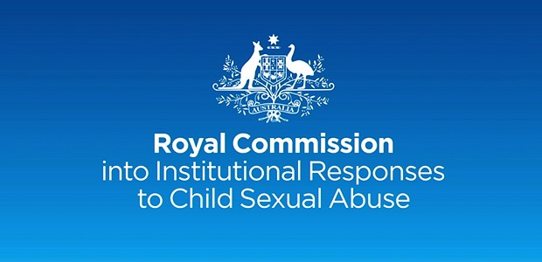
Australia
The Royal Commission into Institutional Responses to Child Sexual Abuse published their final report in 2017 with recommendations for organisations including churches.
Based on these recommendations, the Association of Australian Christadelphian Ecclesias (AACE) published a Child Safety Policy as a template for Child Safety policies in ecclesias (September, 2019).
The AACE has advised each ecclesia to make their own decision about participation in the National Redress Scheme.

Slide 5
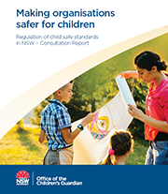
NSW - ecclesias
The Children’s Guardian Act 2019 commenced on 1st March 2020. It brought together existing legislation under one Act.
It defines a religious body as:
a body established for a religious purpose, and
an entity that establishes, or directs, controls or administers, an educational or other charitable entity that is intended to be, and is, conducted in accordance with religious doctrines, beliefs or principles.

Slide 6
Working with Children Checks

Slide 7
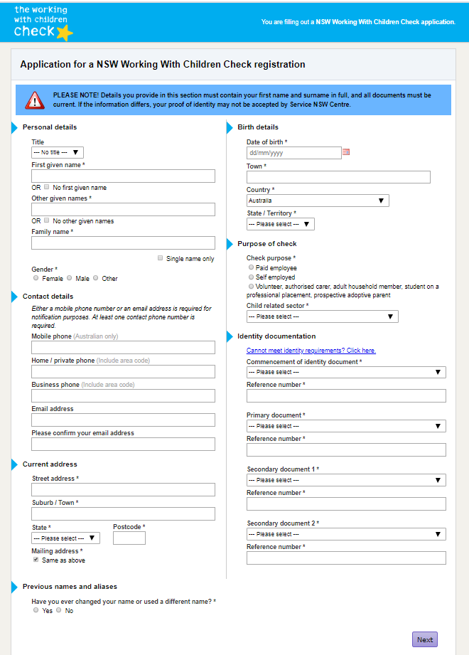
NSW Working with Children Check (WWCC)
Under the Children’s Guardian Act 2019, an employee of an entity includes:
a person engaged by a religious body where that person holds, or is required to hold, a Working with Children Check for the purposes of their work with the religious body.
The Child Protection (Working with Children) Act 2012
Requires all “employers” (which includes ecclesias) to verify and record the WWCC clearance details. These records are audited by the Office of the Children’s Guardian.

Slide 8
Who must have a WWCC?
Child Protection (Working with Children) Regulation 2013
Part 2 Clause 13 Religious services
Work for a religious organisation where children form part of the congregation or organisation is child-related work, if the work is carried out:
(a) as a minister, priest, rabbi, mufti or other like religious leader or spiritual officer of the organisation, or
(b) in any other role in the organisation involving activities primarily related to children, including youth groups, youth camps, teaching children and child care.
Notes:
The Child Protection (Working with Children) Regulation 2013 is the law in NSW for Working With Children Checks.
It applies to all sorts of organisations that provide services for children including schools, sporting clubs and churches.
Child Protection (Working with Children) Regulation 2013
Current version for 27 May 2019 to date (accessed 19 October 2019 at 14:33) Part 2 Clause 13
Reference: https://www.legislation.nsw.gov.au/#/view/regulation/2013/156/part2/sec13

Slide 9
Reportable conduct

Slide 10
NSW - Reportable Conduct
The Children’s Guardian Act expanded the NSW Reportable Conduct Scheme, bringing faith-based organisations into the Scheme.
Reportable conduct is defined as a sexual offence, sexual misconduct, ill treatment, neglect, assault offence under 43B or 316A of the Crimes Act 1900 and behaviour that causes significant emotional or psychological harm to a child.
The Recorder/Secretary is responsible for making reports as the ecclesial “head of entity” see the NSW Reportable Conduct Scheme – Fact sheet 2 Heads of entities and reportable conduct responsibilities https://www.kidsguardian.nsw.gov.au/ArticleDocuments/1021/Head_of_entity_responsibilties.pdf.aspx?Embed=Y

Slide 11
NSW - Reportable Conduct
This scheme monitors how organisations investigate and report on types of conduct made against their employees, volunteers or certain contractors who provide services to children.
The scheme covers religious bodies, in response to recommendations of the Royal Commission into Institutional Responses to Child Sexual Abuse.
Fact sheets are available https://www.kidsguardian.nsw.gov.au/child-safe-organisations/reportable-conduct-scheme/fact-sheets

Slide 12
NSW - Reporting
The Head of a Relevant Entity must provide details within 7 business days after becoming aware of an allegation or conviction. The details they must report include:
date report received
type of reportable conduct
name of employee
name and contact details of entity and head of entity
whether Police notified
whether a ROSH report was made
nature of initial risk assessment and management e.g. whether the employee has been moved)
other additional information (if known)
Entities provide an update on the status of the investigation within 30 calendar days and can seek further guidance for a final report. Failing to report to the Children's Guardian by the head of the relevant entity will carry a penalty of 10 penalty units.

Slide 13
Getting our house in order

Slide 14
NSW - policies and procedures
policy
procedures
code of conduct
The Office of the Children’s Guardian state that religious bodies
need to make sure they have systems in place that include:
Working With Children Checks for key roles and verifying of WWCCs online.
A code of conduct.
Policies, including child protection policies that cover identification, prevention and reporting of reportable allegations, conduct and convictions (including by other members).
Processes for dealing with reportable allegations (including procedural fairness and protections for making reportable conduct complaints/notifications/reports).
Recordkeeping and information management handling policies and procedures.
Training on these policies and codes for members.

Slide 15
NSW - penalties apply
penalties
As an employer in child related work, ecclesias have responsibilities under the law.
Refusing to participate in an audit may lead to the ecclesia receiving a fine for non-compliance with the Act.
Under Section 39 of the Act, the Office of the Children’s Guardian has powers to monitor and audit compliance with the Act and Regulation.
More damaging to our community than penalties and fines is the potential for stigma and persecution by the media and the society because some have not lived up to our community expectations.
Notes:
Particularly when we publicly profess:
That Christadelphians endorse the principles of child protection and have strongly recommend that ecclesias develop, adopt and apply child protection policies consistent with Scriptural principles and applicable legislation at our Biennial Conferences.
Our Commandments of Christ declare (51) — Obey rulers; submit to every ordinance of man for the Lord’s sake (Titus 3:1; 1 Peter 2:13).
Our Commandments of Christ declare (45) — Whatever you do, consider the effect of your action on the honour of God’s name among men. Do all to the glory of God (1 Corinthians 10:31; 3:17).
That the Bible teaches that children are God’s heritage (Matthew 19:14; Psalm 127:3).
That the Bible teaches that all forms of abuse, including child abuse, violate the commandments of Christ and are contrary to the fruit of the spirit (Galatians 5:19-21; Ephesians 5:3-12; 1 Corinthians 6:9-10).

